Slide 1
Remote Access Protocols

Slide 2
Remote Access Protocols
Remote access is a service that allows a client to connect with and log on to a server, LAN, or WAN in a different geographical location
Remote access requires a type of RAS (remote access server)
There are two types of remote access servers:
Dedicated devices
Software running on a server
Types of remote access include:
Remote file access
Terminal emulation, also called remote virtual computing
VPN (virtual private network)

Slide 3
Remote File Access
FTP (File Transfer Protocol) provides remote file access
Three related technologies include the following:
FTPS (FTP Secure or FTP over SSL) offers an added layer of protection for FTP using SSL/TLS
SFTP (Secure FTP) is a file-transfer version SSH that include encryption and authentication for transferring files
TFTP (Trivial FTP) is a simple protocol similar to FTP except that it includes no authentication or security for transferring files

Slide 4
Terminal Emulation (1 of 4)
A terminal emulator is software that allows a user on one computer (client) to control another computer (host or server)
Examples of command-line software:
Telnet and SSH
Examples of GUI-based software:
Remote Desktop for Windows
join.me
VNC
Team Viewer

Slide 5
Terminal Emulation (2 of 4)
Telnet is a terminal emulation utility that allows an administrator or other user to control a computer remotely
It provides little security for establishing a connection (poor authentication)
It provides no security for transmitting data (no encryption)

Slide 6
Terminal Emulation (2 of 4)
SSH (Secure Shell) is a collection of protocols that provides for secure authentication and encryption
Guards against a number of security threats
Unauthorised access to a host
IP spoofing
Interception of data in transit
DNS spoofing
Secure connection requires SSH running on both client and server
Allows for password authentication using public and private key generation

Slide 7
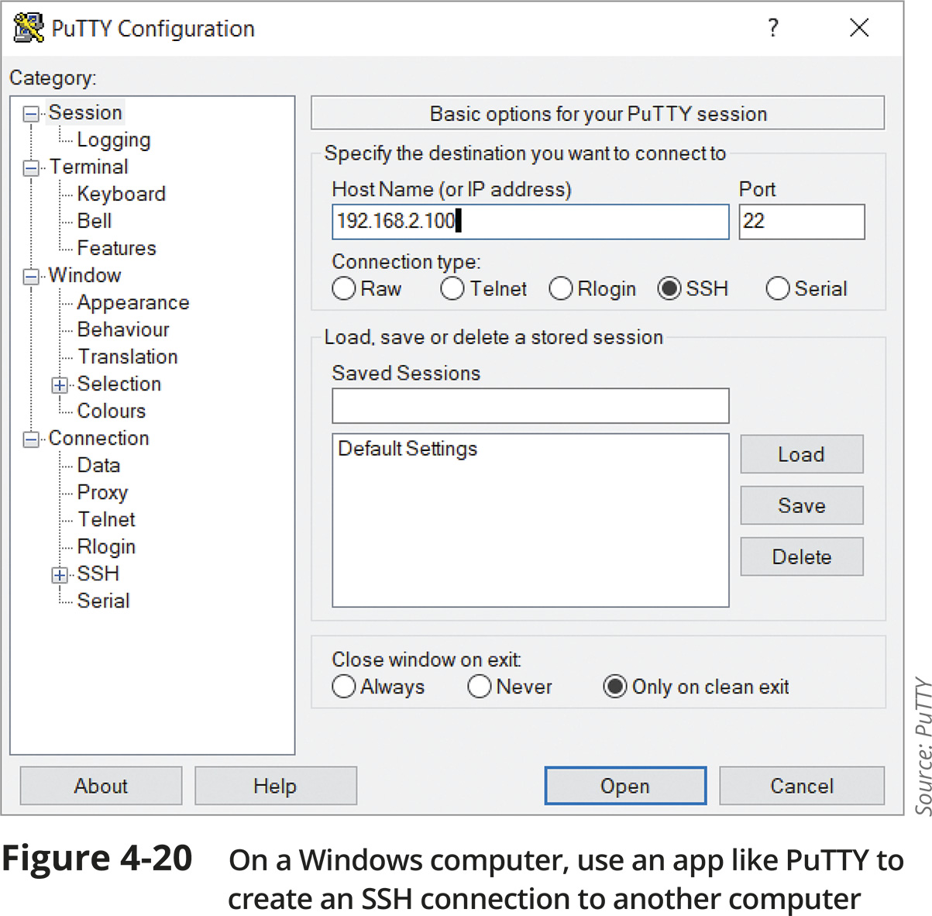
Terminal Emulation (3 of 4)

Slide 8
Terminal Emulation (4 of 4)
RDP (Remote Desktop Protocol) is a Microsoft proprietary protocol used to connect to and control a remote computer
VNC (Virtual Network Computing) uses the cross-platform protocol RFB (remote frame buffer) to remotely control a workstation or server
VNC is open source so many companies have developed their own software that can:
Run OSes on client computers
Remotely access computers, tablets, and smartphones
Remotely control media equipment and surveillance systems

Slide 9
Terminal Emulation (4 of 4)
Out-of-band management relies on a dedicated connection between the network administrator’s computer and each network device
A remote management card is attached to the network device’s console port
A single device, such as a console server or console router, provides centralised management of all linked devices

Slide 10
VPNs (Virtual Private Networks) (1 of 4)
A VPN is a network connection encrypted from end to end that creates a private connection to a remote network
A VPN is sometimes referred to as a tunnel
VPNs can be classified according to three models:
Site-to-site VPN
Client-to-site VPN
Also called host-to-site VPN or remote-access VPN
Host-to-host VPN

Slide 11
VPNs (Virtual Private Networks) (2 of 4)
To ensure VPNs can carry all types of data securely, special VPN protocols encapsulate higher-layer protocols in a process known as tunneling
Many VPN tunneling protocols operate at the data link layer to encapsulate the VPN frame into a network layer packet
Some VPN tunneling protocols work at Layer 3, which enables additional features and options

Slide 12
VPNs (Virtual Private Networks) (2 of 4)
Most tunnelling protocols rely on an additional encryption protocol to provide data security
Common VPN tunnelling protocols include:
L2TP (Layer 2 Tunnelling Protocol)
GRE (Generic Routing Encapsulation)
Open VPN
IKEv2

Slide 13
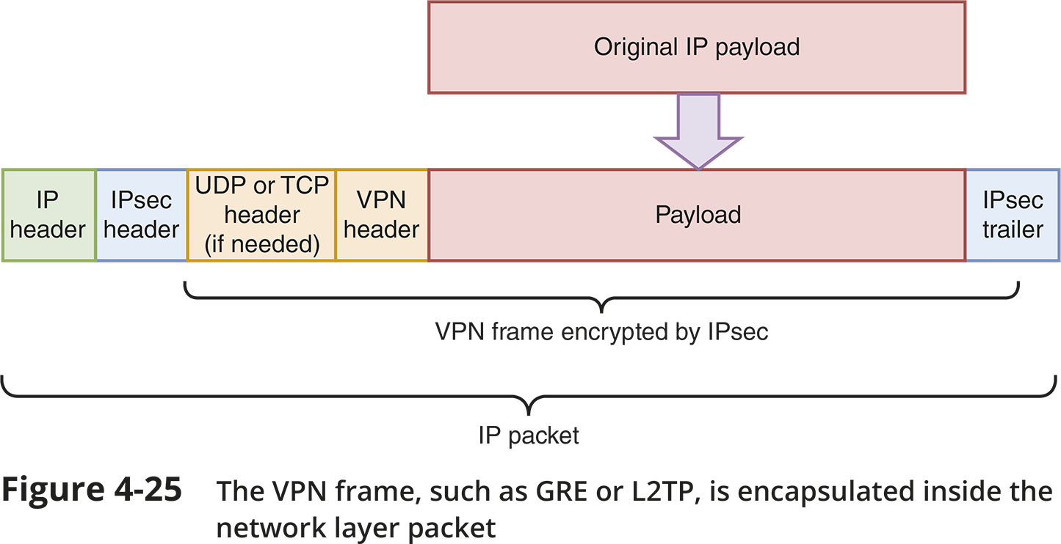
VPNs (Virtual Private Networks) (3 of 4)

Slide 14
VPNs (Virtual Private Networks) (4 of 4)
Cisco developed a proprietary protocol called mGRE (multipoint GRE) that allows the configuration of multiple tunnel destinations on a single interface
A type of enterprise VPN using Cisco devices is called DMVPN (Dynamic Multipoint VPN)
DMVPN dynamically creates VPN tunnels between branch locations as needed rather than requiring constant, static tunnels for site-to-site connections

Slide 15
Remote Access Policies
Common requirements of a good remote access policy:
Remote access devices must be up to date with patches, anti-malware software, and a firewall
Device access must be controlled by a strong password or biometric measures
Passwords must be strong and must be changed periodically
The device’s internal and external storage devices must be encrypted

Slide 16
Remote Access Policies
Common requirements of a good remote access policy:
Company and customer data must be kept secure
The loss or theft of any devices used for remote access must be reported immediately
Encrypted VPN software must be used to remotely access company network resources
While remotely connected to the company network, the device must not be connected to the open Internet, or any other network not fully owned or controlled by the employee
Remote sessions must be terminated when not in use

